Slide 1

Let's have a look at what we covered yesterday
Configuration & Data Handling
Splunk Configuration Files
How Data is Handled in Splunk
Concept of Basic Forwarding

Slide 2
Configuration & Data Handling Splunk Configuration Files How Data is Handled in Splunk Concept of Basic Forwarding
Day 04
Today’s Agenda

Slide 3
There are four key concepts of how data is handled in Splunk:
● Data inputs
● Data Parsing
● Data Indexing
● Data Searching

Slide 4
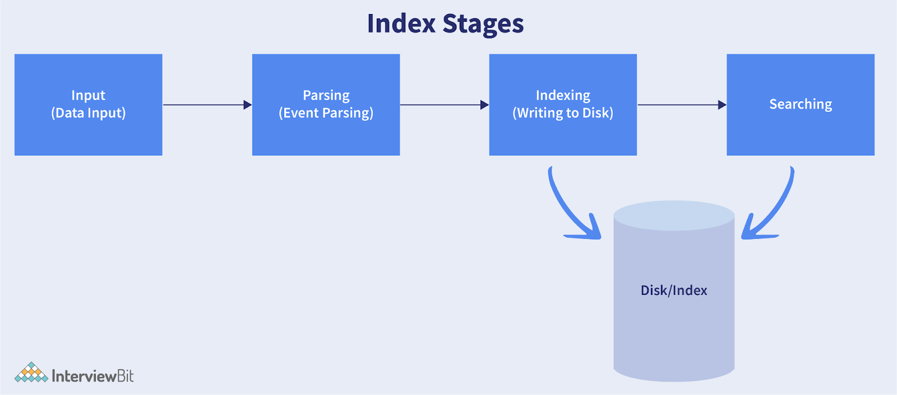

Slide 5
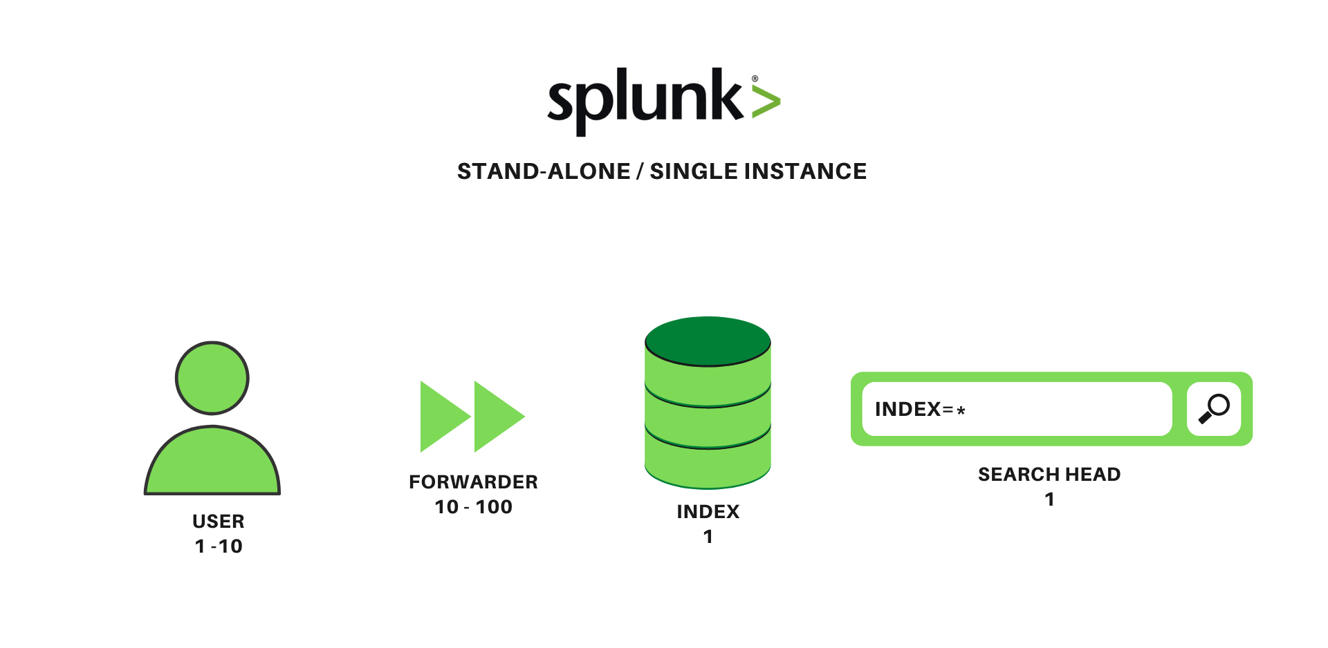
Standalone Deployment: A standalone deployment in Splunk means that all the functions that Splunk does are managed by a single instance. Various functions that a Standalone Deployment can do are: Searching. Indexing, parsing and ingestion.

Slide 6
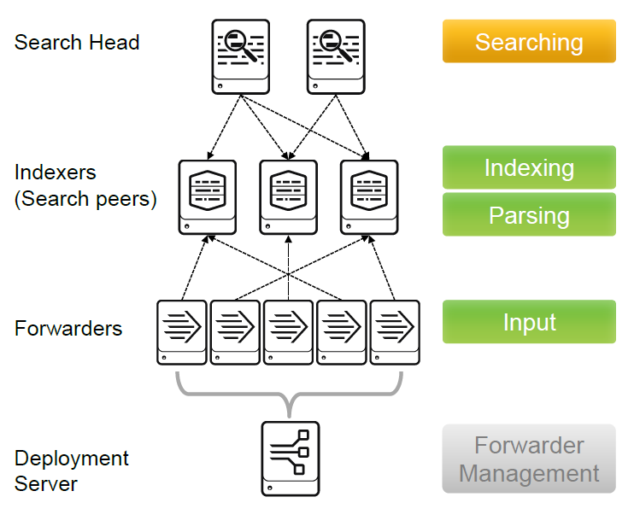
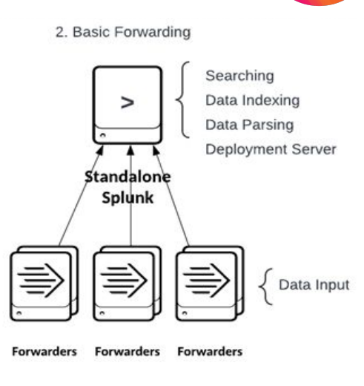
Distributed Deployment

Slide 7
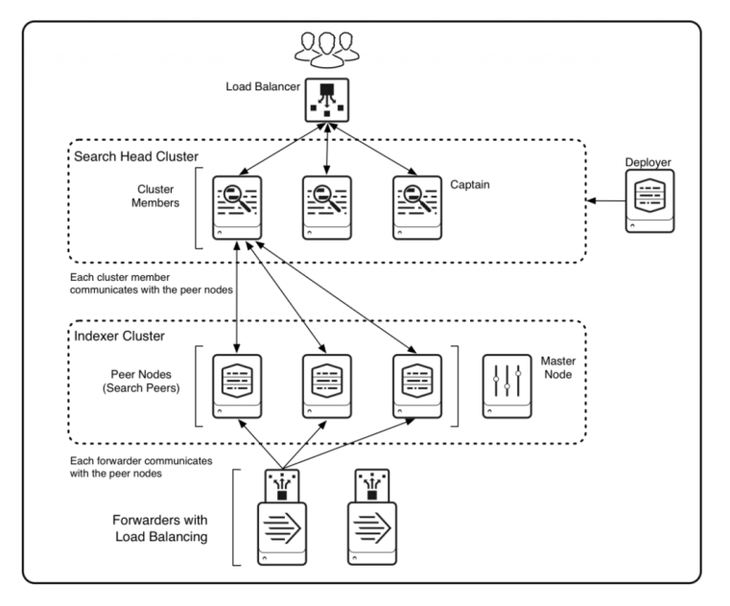
Clustered Deployment:

Slide 8
Key factors that determine the type of deployment:
● Indexing volume
● Number and type of searches
● Number of concurrent users
● Data fidelity requirements (No Data loss should occur)
● Availability requirements
● Disaster recovery requirements

Slide 9
Getting Data into splunk from a forwarder:
Install splunk package on one server.
Install universal forwarder on another server and make sure splunk service is
running.
Create inputs.conf file in order to monitor log file <This will help splunk to
understand what file splunk needs to monitor>
Create outputs.conf file <This will help splunk to understand where to send data>
Restart splunk service on both servers
Note: In order to verify if data is getting ingested Go to Apps → Search &
Reporting App → Search <index=<index_name>>
If you see the data is coming that means you have successfully ingested data
into splunk.

Slide 10
******************************************************************
Content inside Inputs.conf
********************************************************************
[monitor://</path/of/file/abc.txt>]
Disabled = 0
Index = <index_name>
*****************************************************************************
Content inside Outputs.conf file
*****************************************************************************
[tcpout]
defaultGroup=my_indexers
[tcpout:my_indexers]
server=mysplunk_indexer1:9997
[tcpout-server://mysplunk_indexer1:9997

Slide 11
What’s Coming Next?
Cloud Integration Special
Integrating Splunk with AWS
Real-time Use Cases and Dashboards

Slide 12
THANK YOU

